Slide 1
The most interesting and expensive foreigners – what do you know about them?
Kuldiga Technology and tourism technical school
Cabinet makers/ furniture designers
Business English
2020/2021.
Teacher Dace Cine

Slide 2
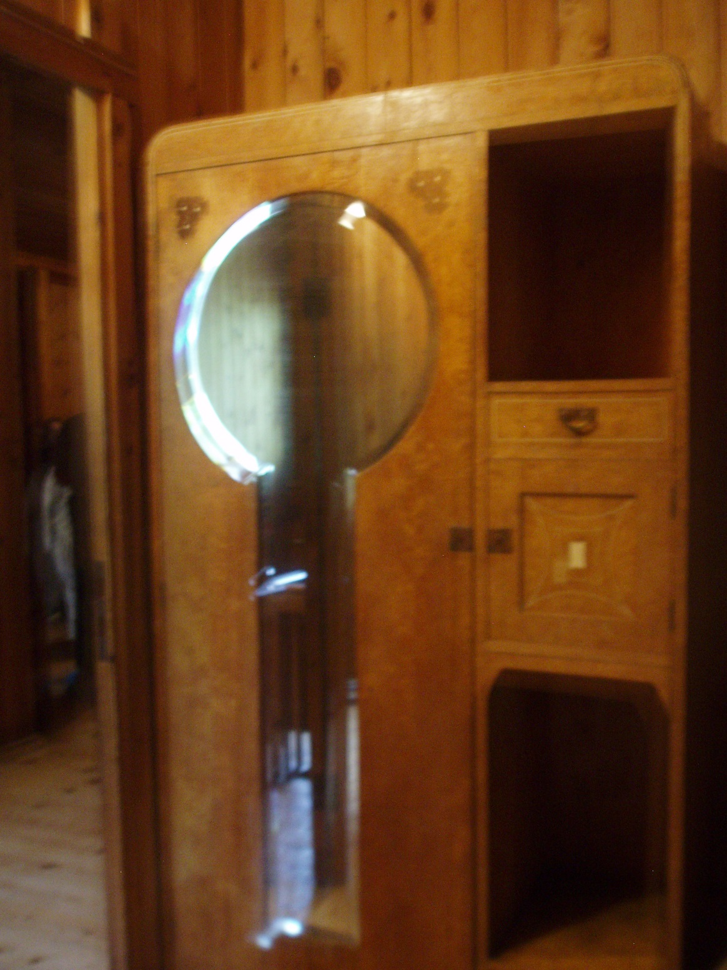
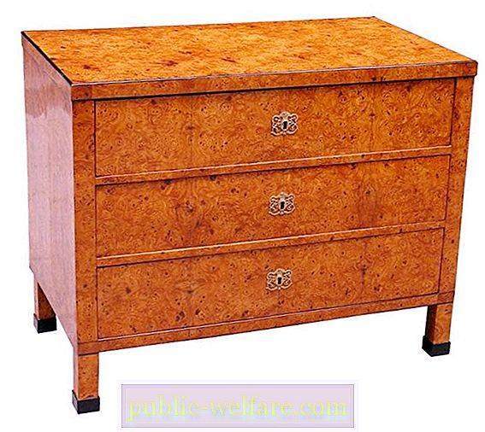
Karelian birch

Slide 3
Could you research:
What differences could you name between the timber of Karelian birch and birch in Latvia?
What is the most effective benefits of Karelian birch timber for furniture?
Could you describe the Karelian birch and Latvian birch conditions of growing?

Slide 4
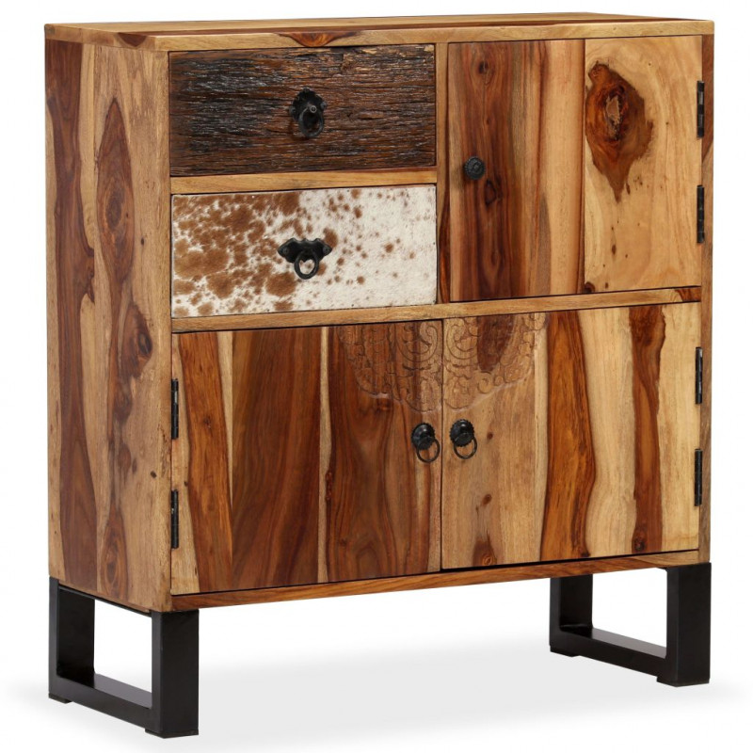
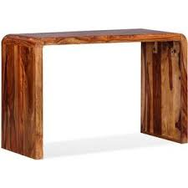
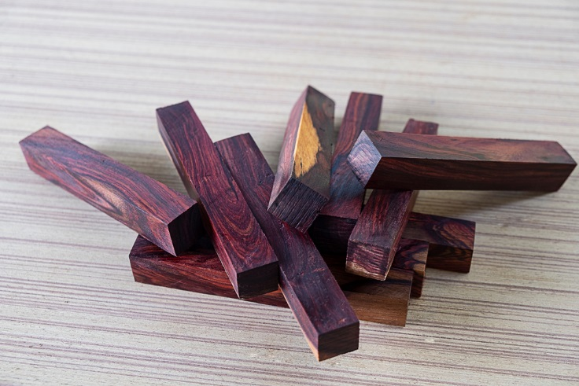
Brasilian Rose tree

Slide 5
Could you research:
What are the timber’s qualities
What is the most effective benefits of Brasilian rosewood for furniture?
Could you give a short description of rosetree growing?
What is the price of this timber?

Slide 6
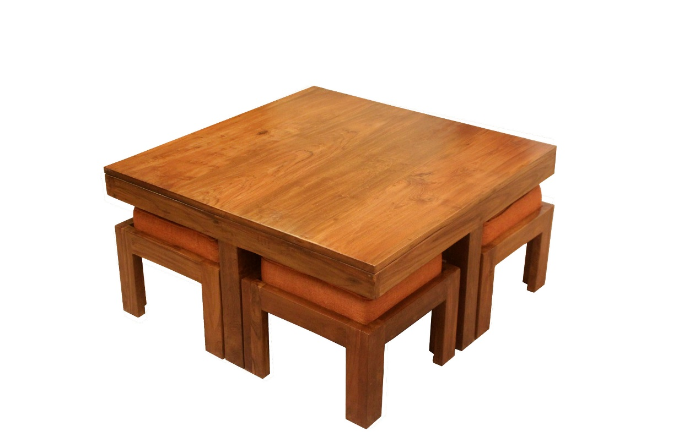
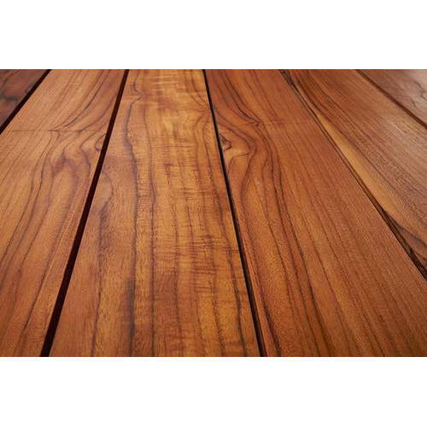
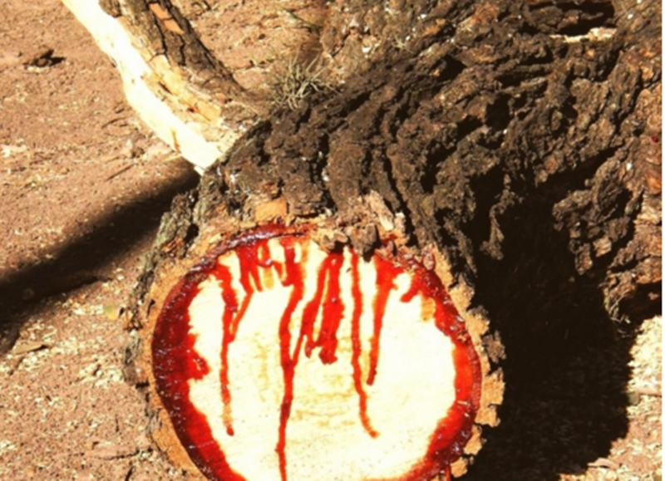
Teak wood

Slide 7
Could you research:
What are the timber’s qualities
What is the most effective benefits of teak wood for furniture?
Please compare Sap water (aplievas ūdens/sula) of birch and teak

Slide 8
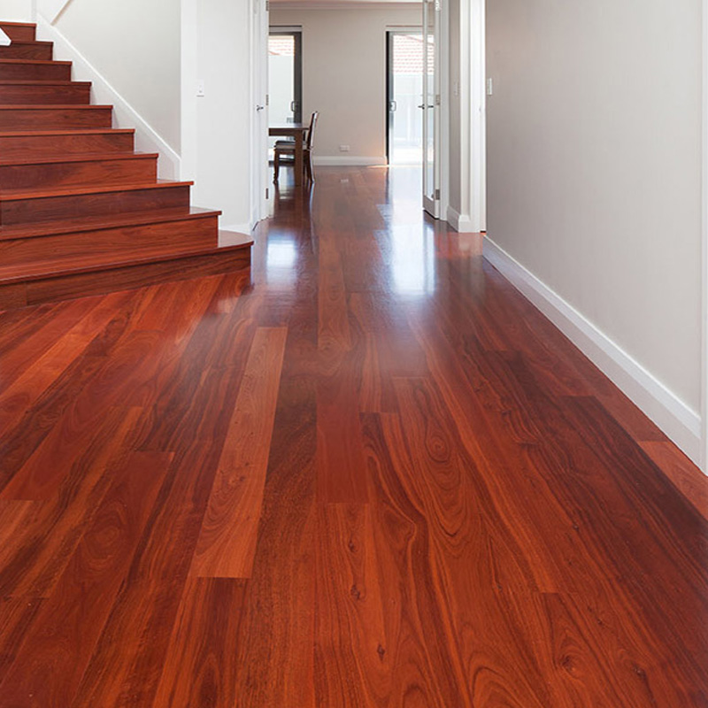
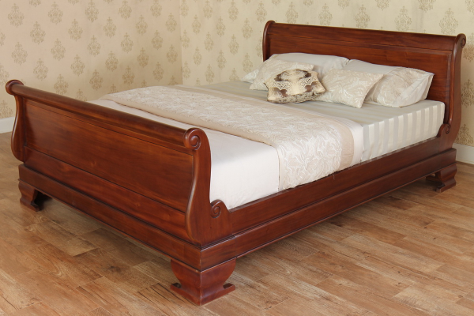
Mahogany

Slide 9
Could you research:
What are the timber’s qualities?
What is the most effective benefits of mahogany wood for furniture?
Can we buy this timber in Latvia?
What is the price of this timber?

Slide 10
African blackwood –the most expensive wood in the world

Slide 11
Could you research:
What are the timber’s qualities
What is the most effective benefits of African black wood for furniture?
Could you give a short description of tree growing?
What is the price of this timber?

Slide 12
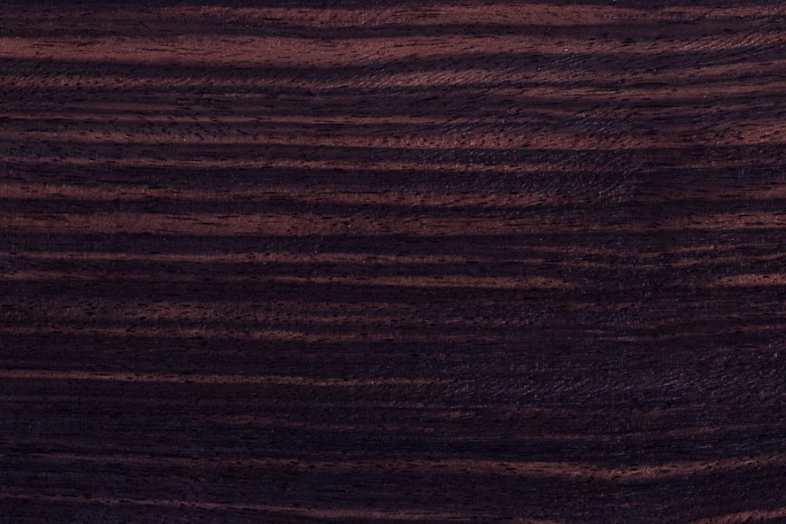
Ebony (southeast Asia)

Slide 13
Could you research:
What are the timber’s qualities?
What is the most effective benefits of ebony wood for furniture?
What effect of colours does hide the trunk and open in the saw timber?
Could you give a short description of ebony tree growing?
What is the density of ebony timber?
What is the price of this timber?

Slide 14
Iron wood

Slide 15
Could you research:
What are the timber’s qualities
What is the most effective benefits of iron wood for furniture?
Could you give a short description of iron tree growing?
What is the price of this timber?

Slide 16
Why do customers want furniture of precious trees
Precious wood – cēlkoki
Think and name the customers’ reasons to order furniture of the precious wood?
What are the advantages of furniture made of the precious wood?

Slide 17
For group discussion or thinking at home :
What about the use of antiseptics of precious wood
What could be flameability of precious wood
Give examples of final film or coating of the furniture made of precious wood
What could be the wear resistance of precious wood

Slide 18
Thank you!
Recources:
* teacher’s Dace Cine private pictures
* https: /ventured.com/most-expensive-woods-in-the-world

