Slide 1

Understanding Modal Verbs
Kuldīgas Tehnoloģiju un tūrisma tehnikums
Loreta Krafta
2024.

Slide 2
Definition
Modal verbs are a type of auxiliary verbs used to express ability, possibility, necessity, permission, request, and more.
can, could, may, might, shall, should, will, would, must

Slide 3
Can/Could
Ability: I can swim.
Possibility: It could rain later.

Slide 4
May/Might
Permission: May I go to the restroom?
Possibility: It might snow tomorrow.

Slide 5
Shall/Should
Shall (formal): Shall we begin?
Should (advice): You should study for the exam.

Slide 6
Will/Would
Will (future): I will help you.
Would (conditional): I would go if I had time.

Slide 7
Must
Necessity: You must submit your assignment on time.

Slide 8
Characteristics of Modal Verbs
Do not have infinitive or -ing forms.
Followed by the base form of the main verb (except for "ought to").
Always precede the subject in a question.
Can be used to express degrees of certainty or probability.

Slide 9
Expressing Degrees of Certainty
Certain: must
It must be true; I saw it myself.
Probable: might, may, could
It might rain later; bring an umbrella.
Possible: can, could
I can meet you at 3 PM if that works for you.

Slide 10
Making Requests and Giving Permission
Can I/Could I: Used for polite requests.
Can I borrow your pen?
May: Used for formal requests.
May I have a moment of your time?

Slide 11
Making Offers and Promises
Will: Used for offers and promises.
I will help you with your project.
Would: Used for polite offers and conditional promises.
I would be happy to assist you.

Slide 12
Expressing Obligation and Necessity
Must: Used for strong obligation and necessity.
You must finish your homework before going out.
Should: Used for advice or recommendation.
You should exercise regularly for good health.

Slide 13
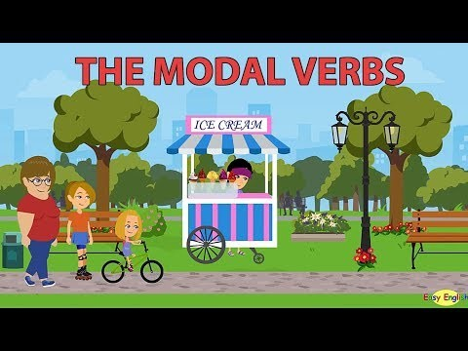

Slide 14
Practice Exercise

Slide 15
Fill in the correct modal verb
1. You have plenty of time. You __________________ hurry.
2. Somebody has knocked on the door. It __________________ be Paul.
3. I can’t start my lawn-mover to work. It __________________ be broken.

Slide 16
Answers
1. You have plenty of time. You should not hurry.
2. Somebody has knocked on the door. It must be Paul.
3. I can’t start my lawn-mover to work. It must be broken.

Slide 17
4. __________________ I ask you what happened yesterday?
5. I’ve managed to complete my To-Do list today. But I ________________ have done it without you.

Slide 18
Answers
4. Can I ask you what happened yesterday?
5. I’ve managed to complete my To-Do list today. But I could not have done it without you.

Slide 19
Conclusion
Modal verbs play a crucial role in expressing various meanings in English.

