Slide 1

The variety of boards
(composite materials)
Curriculum: Cabinet makers
(modulis: valodas,kultūras izpratne un izpausmes)
Skolotājs: Dace Cine
2023
KULDĪGA TECHNOLOGY AND TOURISM TECHNICAL SCHOOL

Slide 2
Oriented strand (kokskaidas) board (OSB)
OSB is a wood panel made using waterproof heat-cured adhesives and wood long strands that are arranged in cross-oriented layers which are then bonded together under heat and pressure.
it uses the whole tree and makes use of crooked, knotty and deformed trees that would otherwise go unused.
a strong, stable panel it generally won’t warp and will resist wind and seismic loads, used in cargo-van panels, pallets, industrial containers, marine applications and furniture manufacturing.
OSB can be chemically treated to improve resistance to decay or to fire.
was invented by Armin Elmendorf in California in 1963

Slide 3
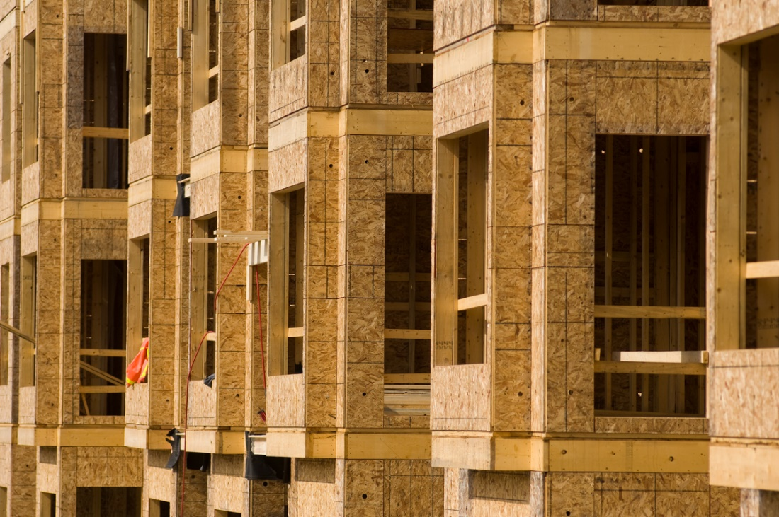
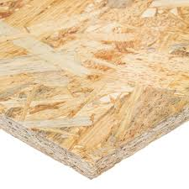
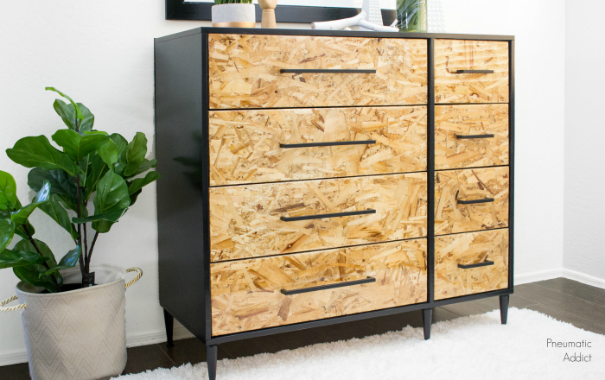
OSB

Slide 4
Particle board
chipboard or low-density fiberboard, is manufactured from wood chips (skaidas) and a synthetic resin or other suitable binder, which is pressed and extruded.
Different grades of particleboard have different densities
disadvantage of particleboard is its susceptibility to expansion and discoloration from moisture absorption
first produced in 1887, Germany

Slide 5
Medium density fibreboard (MDF)
made by breaking down hardwood or softwood residuals into wood fibres, combining it with wax and a resin binder, and forming it into panels by applying high temperature and pressure.
stronger and denser than particle board
production of MDF began in the 1980s, in both North America and Europe.
MDF is primarily used for indoor applications due to its poor moisture resistance
does not warp or crack like wood
fire retardant capabilities
MDF is also usable for furniture such as cabinets, because of its strong surface
Veneered MDF provides many of the advantages of MDF with a decorative wood veneer surface layer. In modern construction,

Slide 6
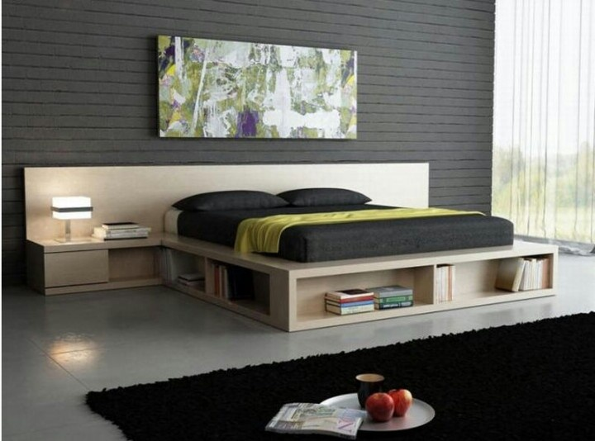
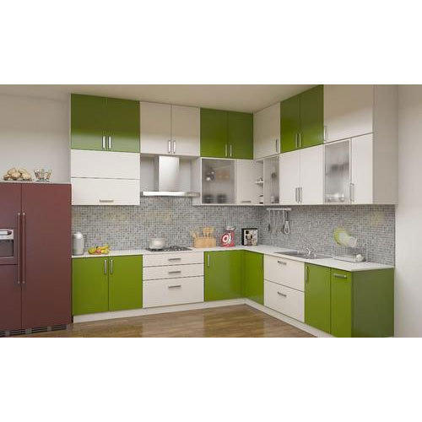
MDF

Slide 7
Plywood
manufactured from thin layers or "plies" of wood veneer that are glued together with adjacent layers having their wood grain rotated up to 90 degrees to one another.
plywoods bind resin and wood fibre sheets - cellulose cells are long, strong and thin
This alternation of the grain is called cross-graining
important benefits: it reduces the tendency of wood to split when nailed at the edges; it reduces expansion and shrinkage, providing improved dimensional stability

Slide 8
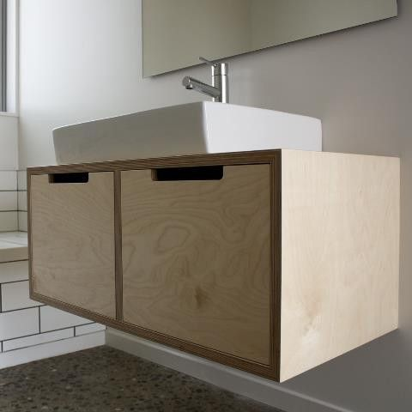
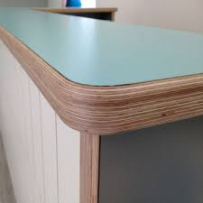
Plywood

Slide 9
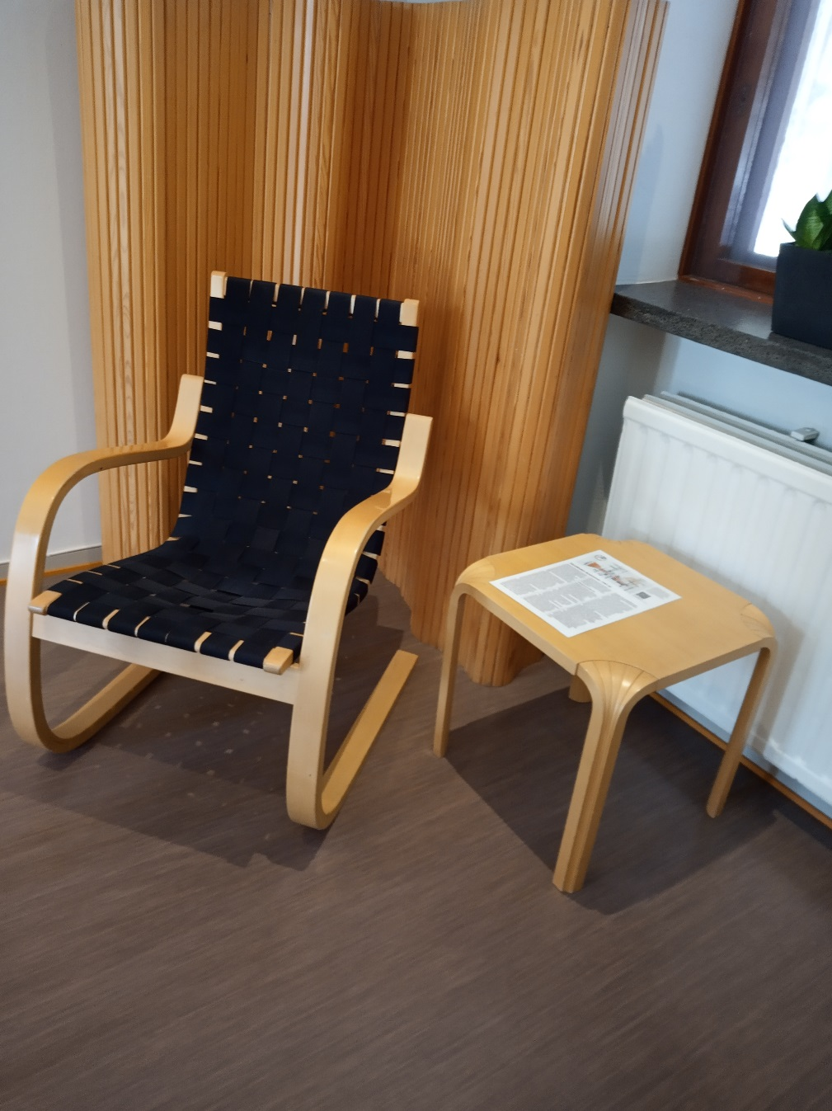
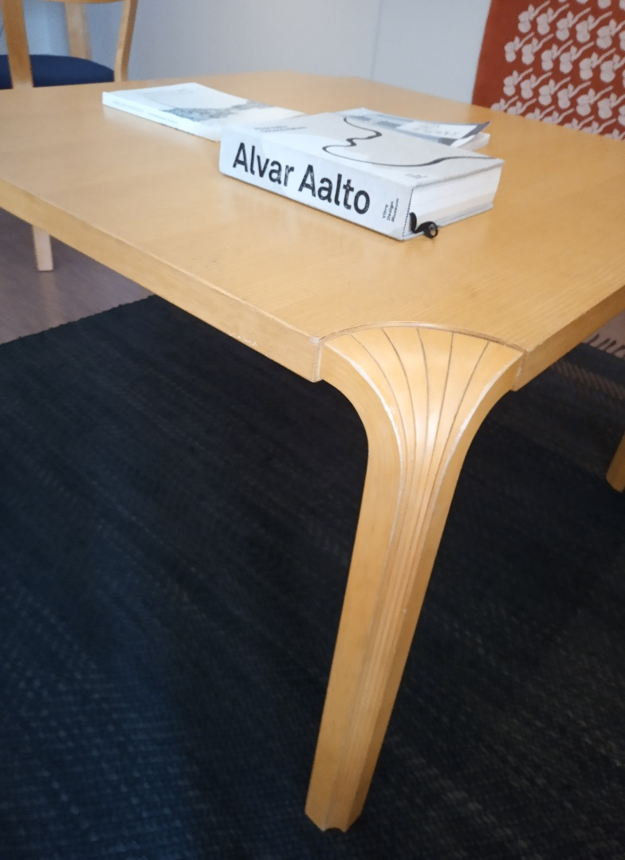
Furniture of plywood (Alvar Aaalto)

Slide 10
Cross laminated timber (CLT)
wood panel product made from gluing together layers of solid-sawn lumber, - lumber cut from a single log.
each layer of boards is usually oriented perpendicular to adjacent layers and glued on the wide faces of each board, usually in a symmetric way so that the outer layers have the same orientation.
CLT was first developed and used in Germany and Austria in the early 1990s

Slide 11
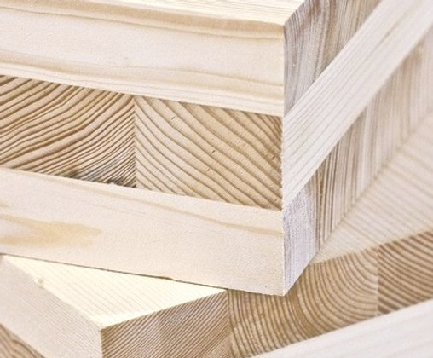
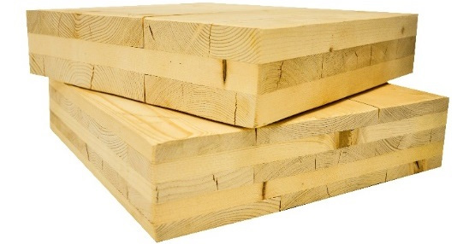
Cross laminated timber

Slide 12
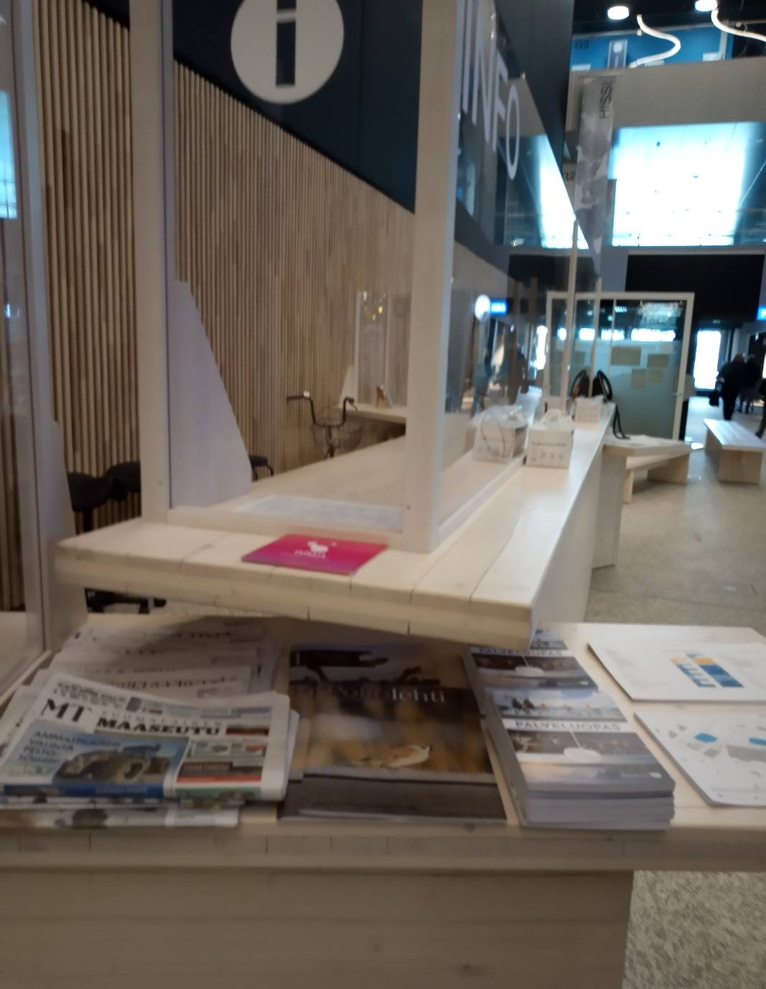
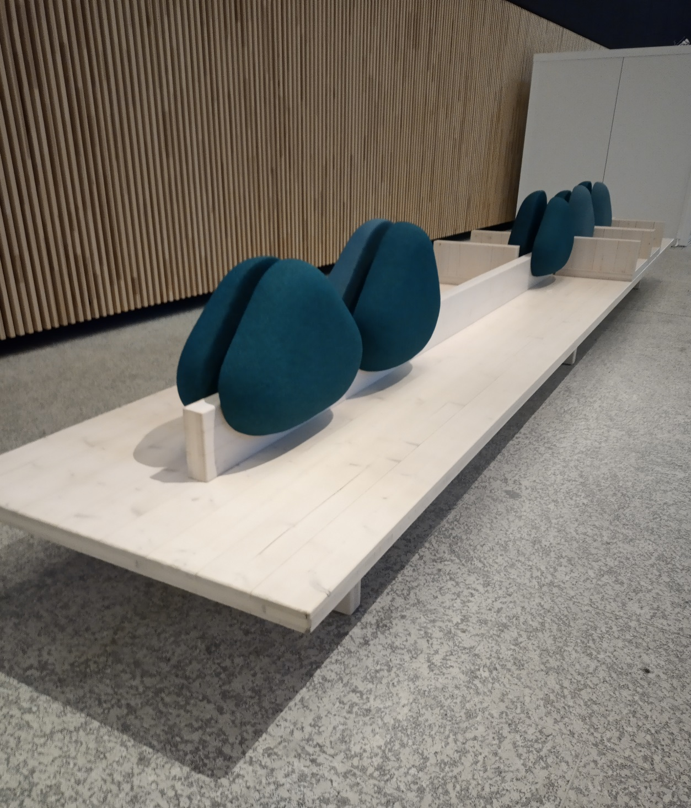
Furniture of CLT (Juvaskylla, Somija)

Slide 13
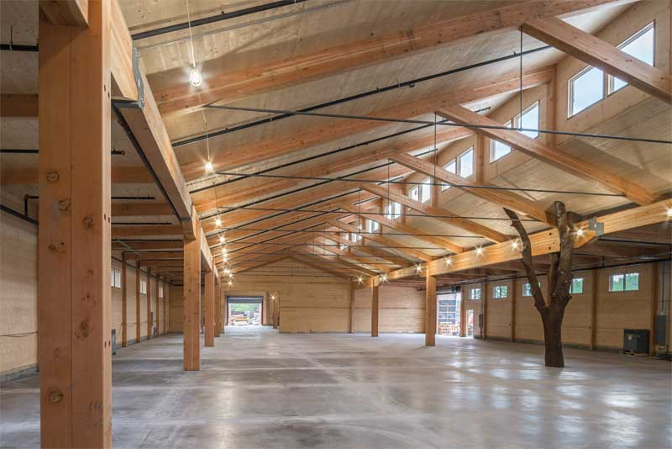
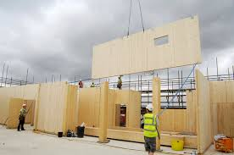
Limbaži

Slide 14
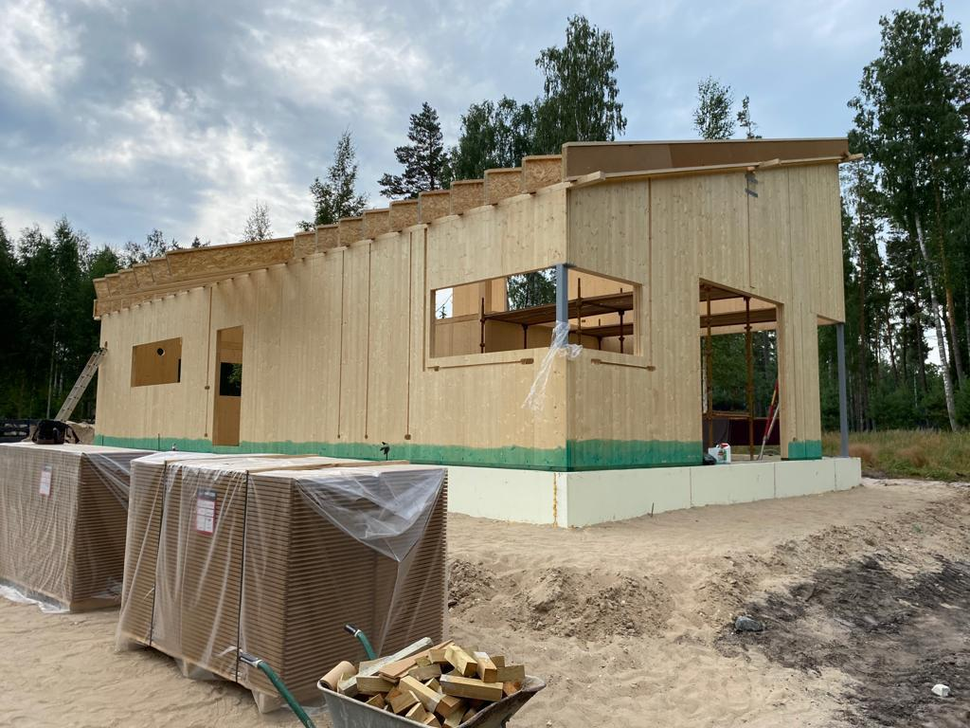
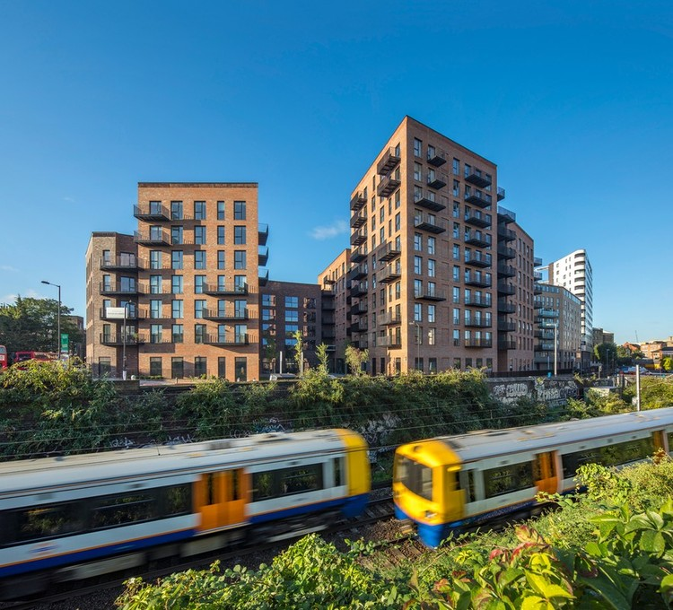
Limbaži
London, 2017

Slide 15
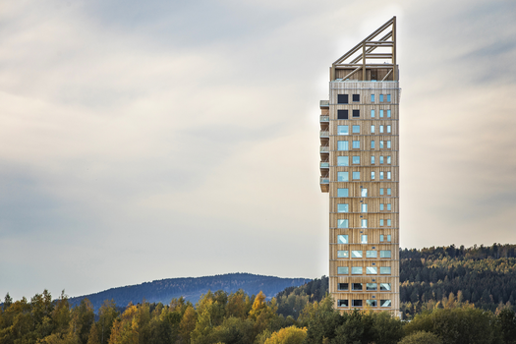
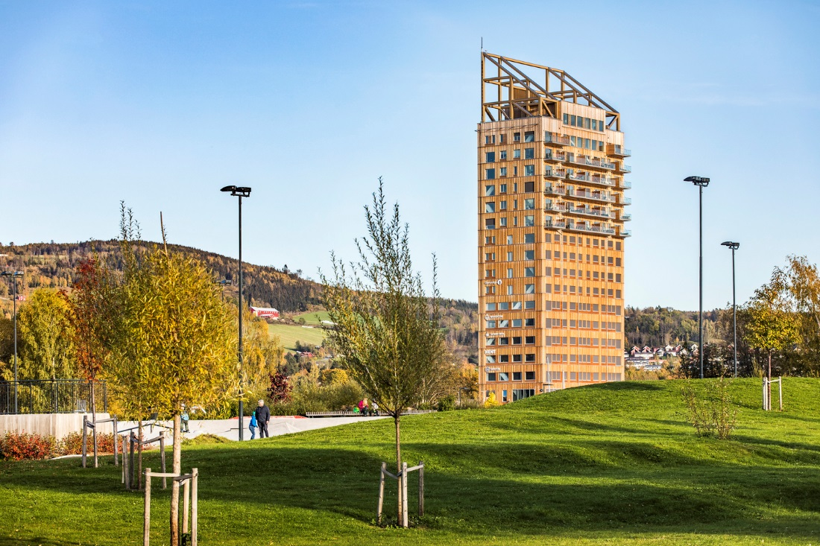
The highest CLT building, Norway – 18 floors (85,4m)

Slide 16
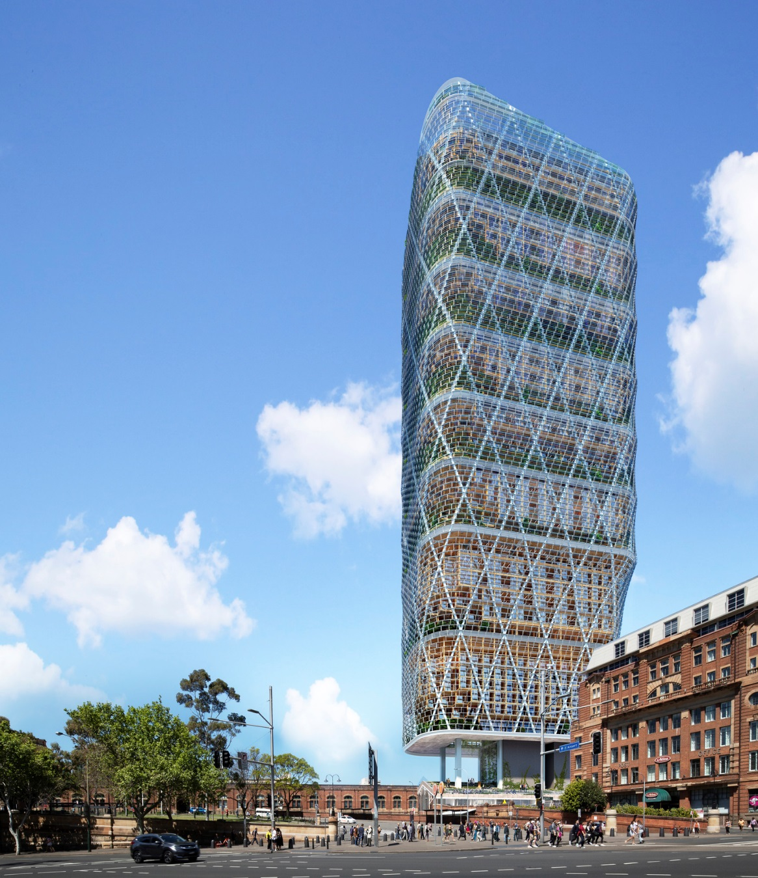
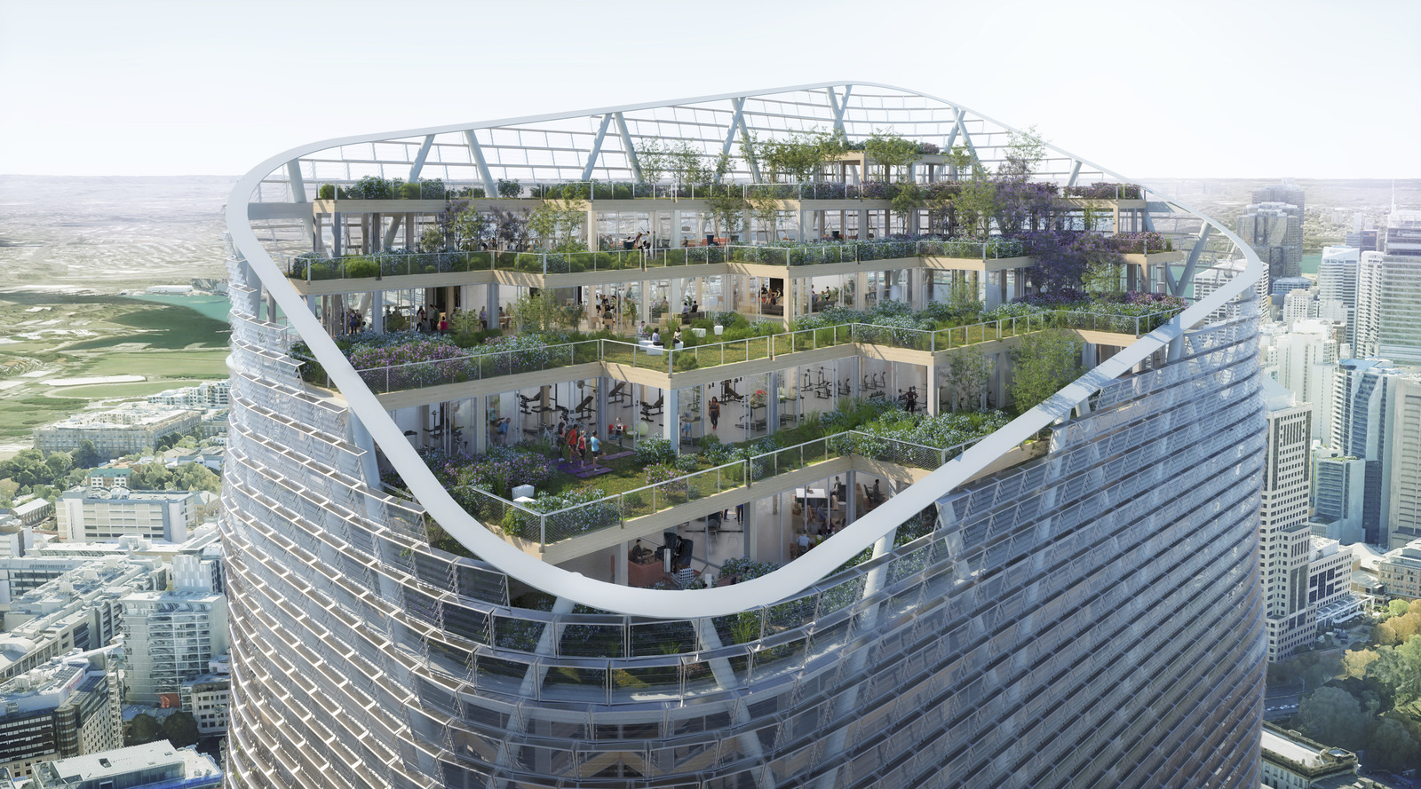
The wooden house of CLT – Sydny, Australia, 40 floors, 180m (Year of 2025)

Slide 17
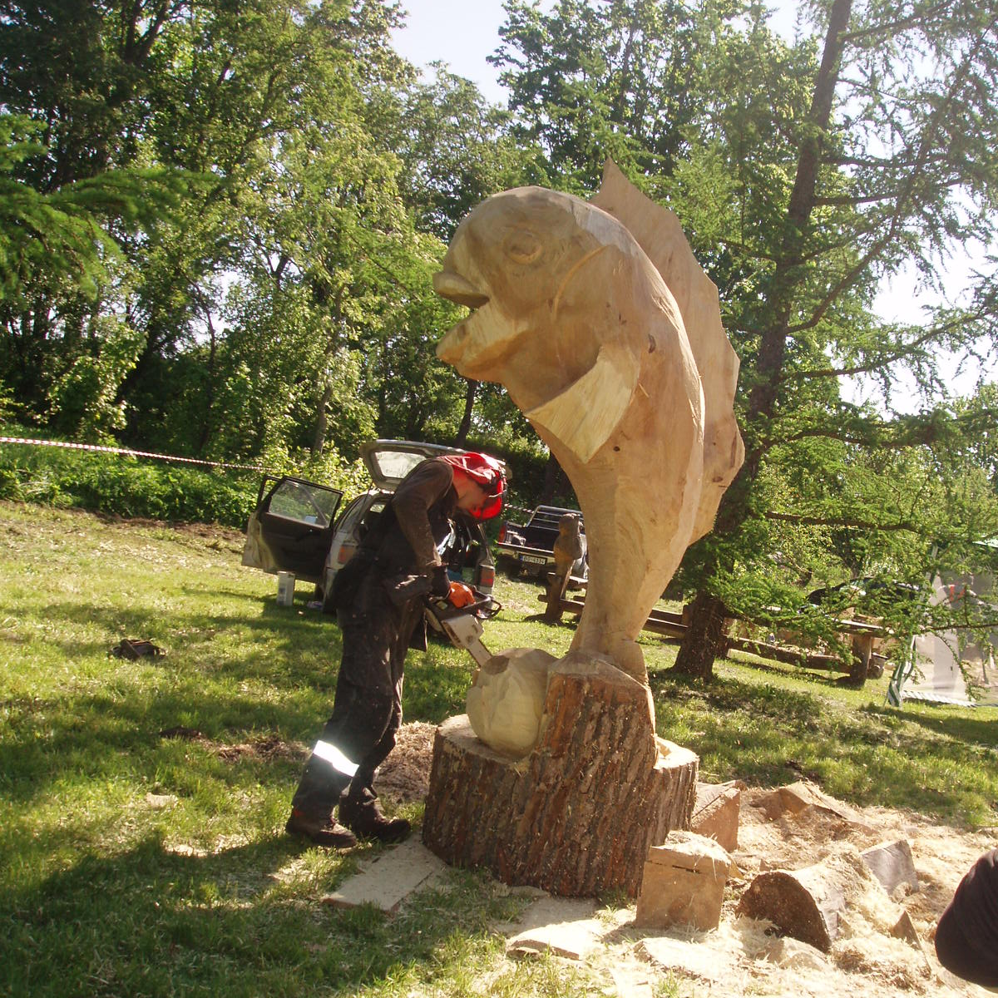
Dace Cine, English teacher
Resource: https://www.youtube.com/watch?v=TwaIzv-M4N4 https://archidea.lv/lv/news/article/koka-ekas-aug-augstuma-un-plesas-plasuma-4909/ https://mccoymart.com/post/what-is-a-particle-board-and-its-types/
Thank you !

